Slide 1
Parser XML ~ JSON
Autor : Dănoiu Sabrina - Elena

Slide 2
Implementare
Limbaj: Python
Environment dezvoltare: Miniconda3, Jupyter Notebook
Biblioteci utilizate:
xml
lxml
json
json2xml
xmltodict
easygui
tkinter

Slide 3
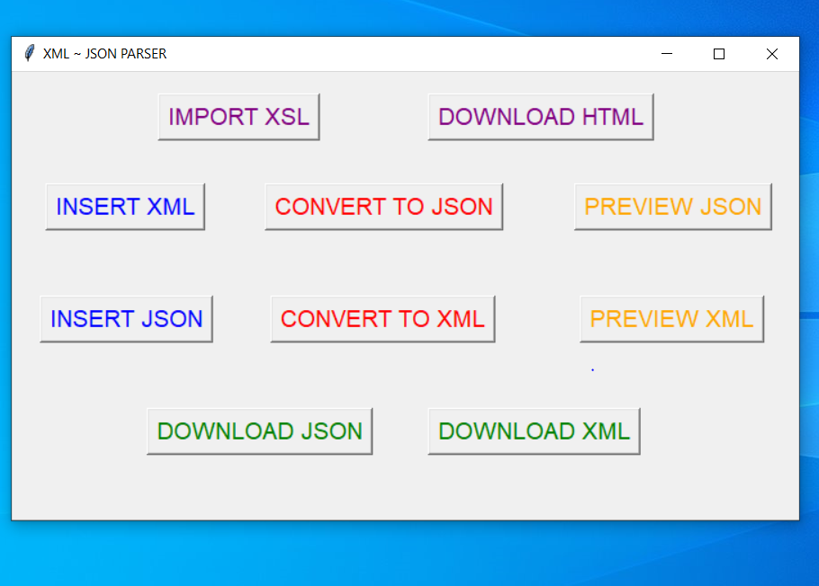
User interface

Slide 4
User experience

Slide 5
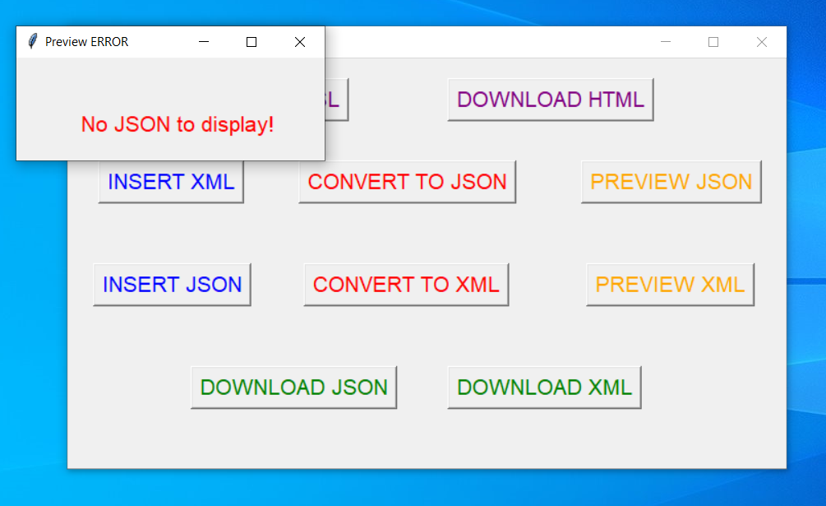
Error handling
Error pop up
specifying the cause
Clicking without doing the other steps

Slide 6
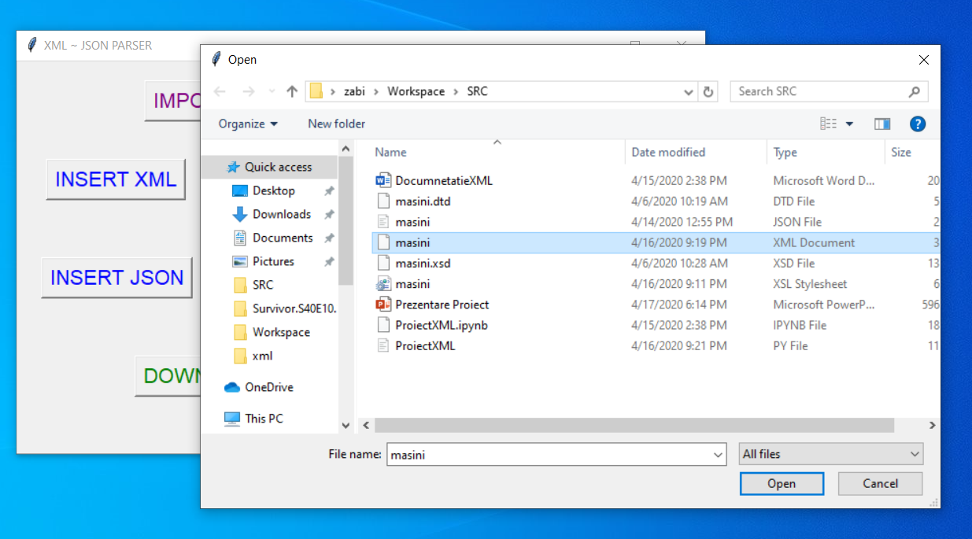
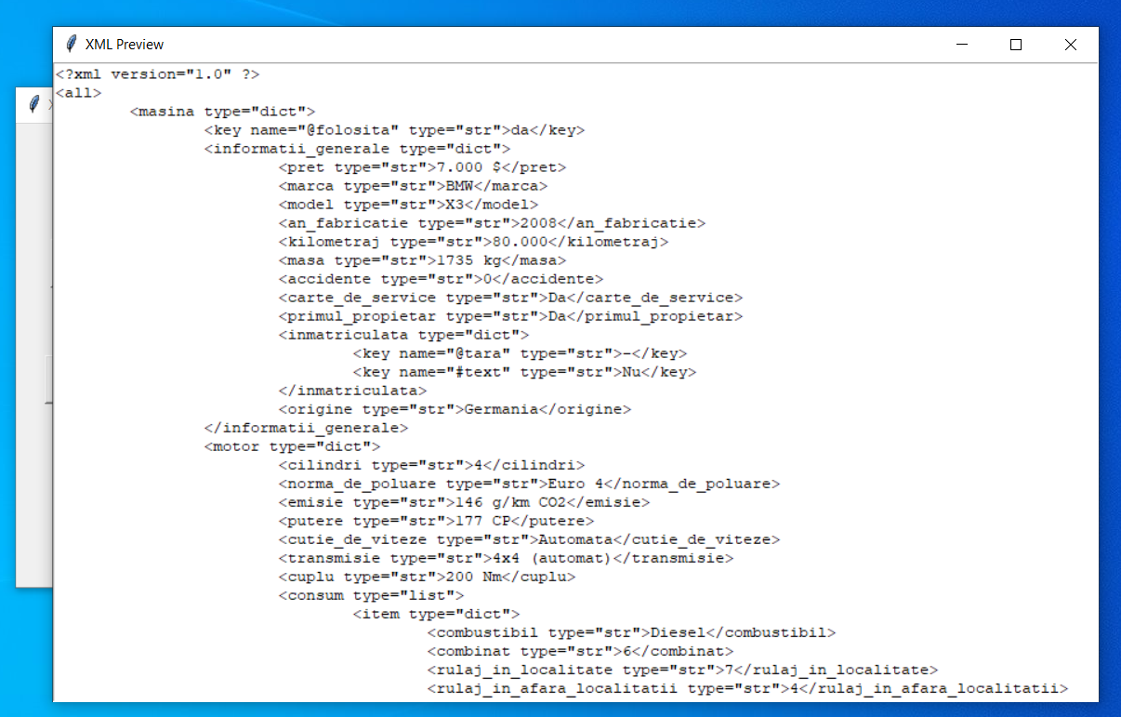
User interactions
Selecting the file to upload using the interface
Previewing the XML resulted by converting a JSON

Slide 7
The END.

